Slide 1
Cryptographic tools for blockchain
Bercovici Adrian, Erhan Adrian, Fechita George Antonio

Slide 2

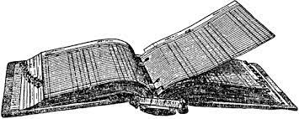
Introduction to blockchain
Blockchain is a technology that seeks to be a kind of digital, decentralized ledger. If formally, a ledger would be kept by just one entity, that the other participants have to trust, Blockchain seeks to give every participant their own copy of ledger and remove the need for trust entirely.

Slide 3
To digitalize a ledger, one of the first problems that must be solved is the need for transactions to reliably be traced back to one particular user who started the transaction. Consider Alice and Bob, two participants in the ledger and a transaction “Alices gives Bob 100$”. They key cryptographic properties of interest in this particular situation are:
• Authentication: or being able to know that this transaction was made by Alice and Alice alone
• Integrity: or being able to know that this transaction was not tempered with by anyone, and that indeed Alice gave Bob 100$ and not 10$ or 1000$
• Non repudiation: or the property that Alice cannot retroactively deny making the transaction

Slide 4
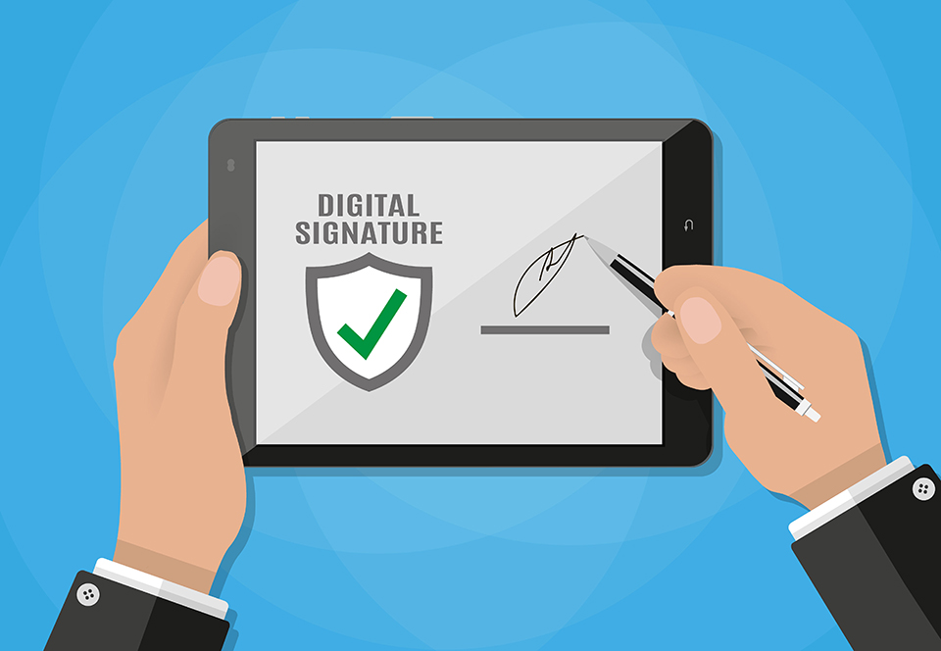

The solution? Digital signatures!

Slide 5
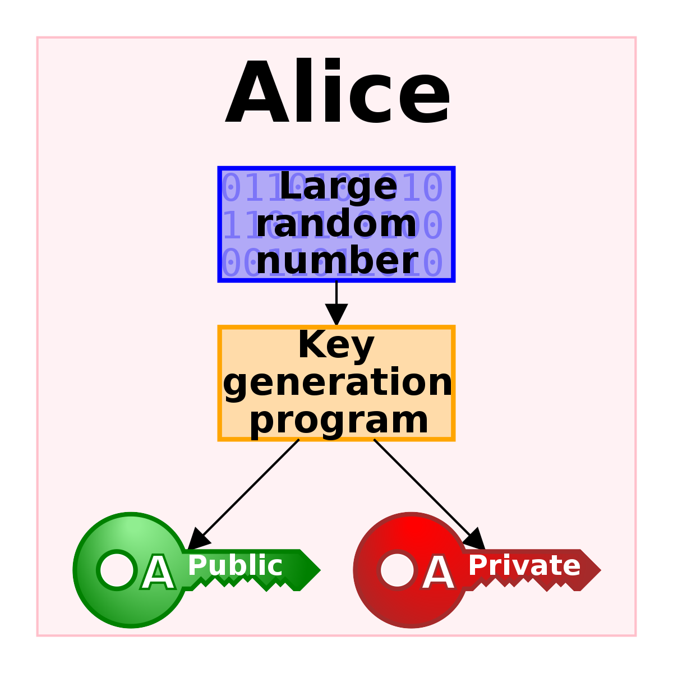
Digital signatures are the cryptographic tool that provides all 3 of the above mentioned, required properties. Now consider that these operations require the context of public key cryptography. Each user will have a pair of keys, one private, used to sign the transaction and one public key, used to verify it. A transaction is not valid unless signed by the user.

Slide 6
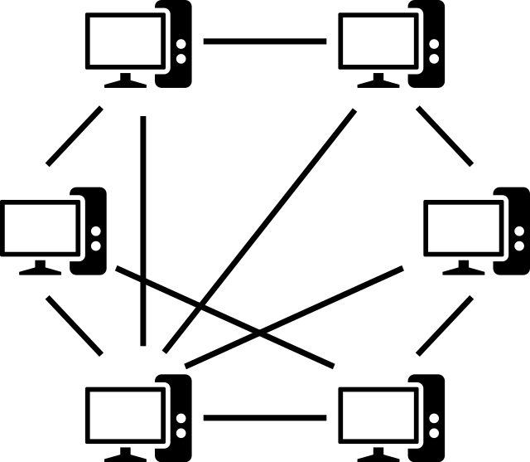
Who keeps track of all transactions when no central authority is present? Well - everyone
When a transaction is made, given there is no one central authority to report it to, the sender has to broadcast the transaction to the other participants in the Blockchain.

Slide 7

Who to trust when two peers hold
conflicting data? Whoever worked harder
Consider a situation where Alice gives Bob 100 $, but only broadcasts this transaction to Bob, in an attempt to fool him. Now Bob’s ledger will show he received 100$ from Alice, but all the other participants’ ledgers will not contain that, as it was not broadcasted to them. This brings forth the second important problem that Blockchain has to solve:
Whose ledger should be trusted? Given two ledgers A and B, the participants will trust will trust the ledger that has the most work put into it

Slide 8
What is “hard work” in the context of blockchain?
To understand the concept of work and proof of work, in the context of Blockchain, a general overview of cryptographic hash functions must first be provided. A cryptographic hash function, like any hash function, maps an infinite space to a finite space. However, unlike regular hash functions, cryptographic hash functions are resistant to collisions, strongly not reversible and appear random. Given two strings of bits, A and A’ where the Hamming distance between the two sequences is exactly one, the digests of a cryptographic hash function ran on the two strings will produces two outputs separated by very large, often maximum Hamming distance, or in simpler terms the two digests will be very distinct from one another

Slide 9


Mining
Consider a block (a list) of transactions, and a nonce - the proof of work is a nonce that when applied to the block of transactions causes the cryptographic hash to have some sort of predefined property such as starting with a particular number of zeros. Due to the pseudo random nature of cryptographic hash functions, it can be assumed with reasonable certainty that computational work had to be performed to obtain a nonce that creates the desired result. This describes the process known as ‘Mining’.

Slide 10
So, once a transaction is made, it is broadcasted to the network, miners add the transaction to the block and search for the proof of work. Once the proof of work is found, the currently last block in the miner’s ledger is hashed and linked to the new block that was just created. Note that a block is not valid without a proof of work. Every to block, except the first, contains transactions, the proof of work and the hash of the previous block. This links the block in a chain that makes it computationally difficult to modify any links in the chain, as that would compromise the following links and would require re-computation of the proof of work.

Slide 11

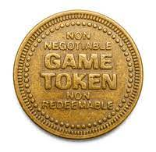
Why bother mining?
To incentives participants to partake in chain building or mining, the user that obtains a proof of work is rewarded with newly generated tokens. Also, since most Blockchain technologies implement a hard cap on the number of transactions that can be added to a block, users can incentives miners to add their transaction to the block by offering a commission.

Slide 12
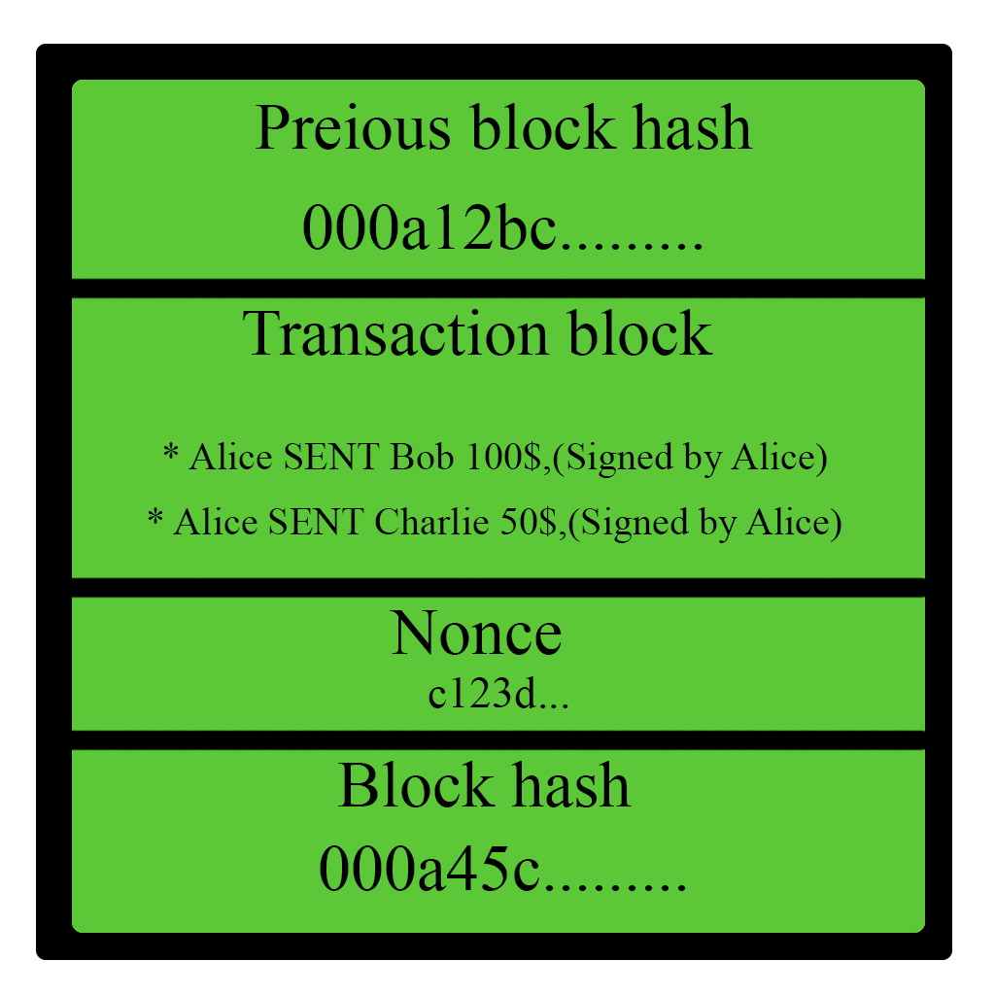
With all this in mind, let’s have a look at the general structure of the bockchain!
A single block in the blockchain contains:
*A hash of its predecessor
*A list of transactions, signed by the users
*A nonce that when hashed together with
the content of the block produces a:
*Block hash with a particular mathematical
property (ex starts with K zeros)

Slide 13
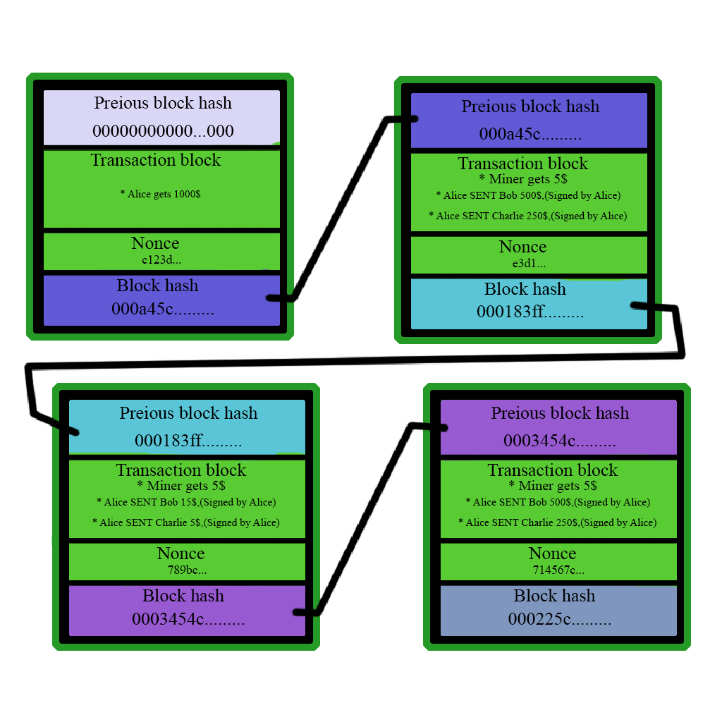

Slide 14
Given the previous chain, let’s consider that Alice would like to edit the second block, as she spent too many tokens. Will the blockchain hold?

Slide 15
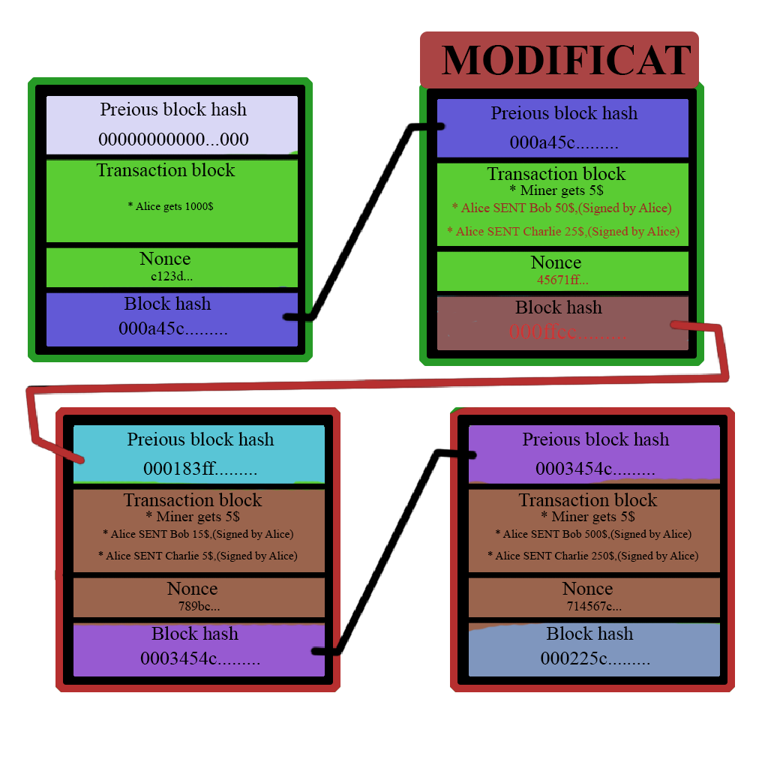

Slide 16
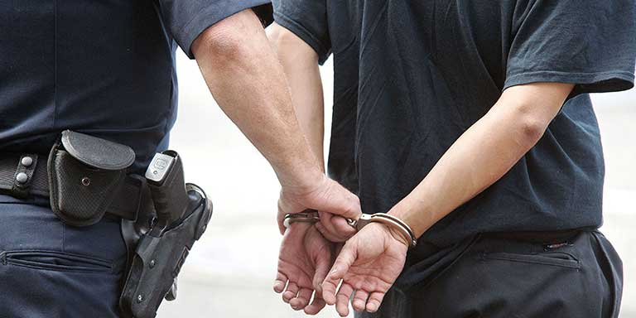
Yes! Everyone in the network now knows of Alice’s treachery!
Even if she re-mines the second block, the hash will still not match to the one linked in the third block. She would have to recompute every link onward starting from the one she edited.

Slide 17
! Trust in a chain builds gradually! The longer the chain, the more trustworthy it is!
It is important to note that the further behind a transaction is in the Blockchain, the more trust worthy it is, because more computational work has been done. Consider the aforementioned situation where Alice makes a transaction to Bob and only broadcasts it to him. Bob will compare Alice’s ledger to the ledgers of the network peers. In order to maintain the illusion that Alice has transferred tokens to Bob, Alice would have to continuously provide more proof of work than the entire network, which is an unfeasible task. Additionally, if a user was to modify any block from the chain, that user would have to recomputed the proof of work for all the links in the chain after that block – which is again, unfeasible.

Slide 18
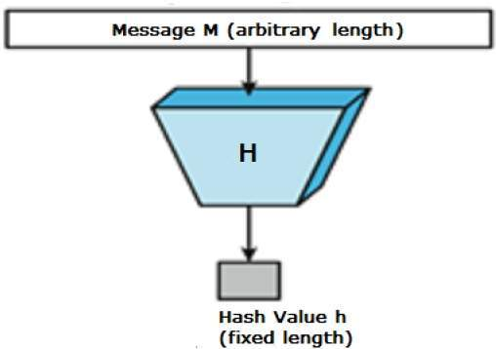
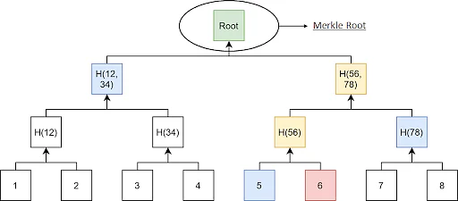
Hash functions & Merkel Trees

Slide 19
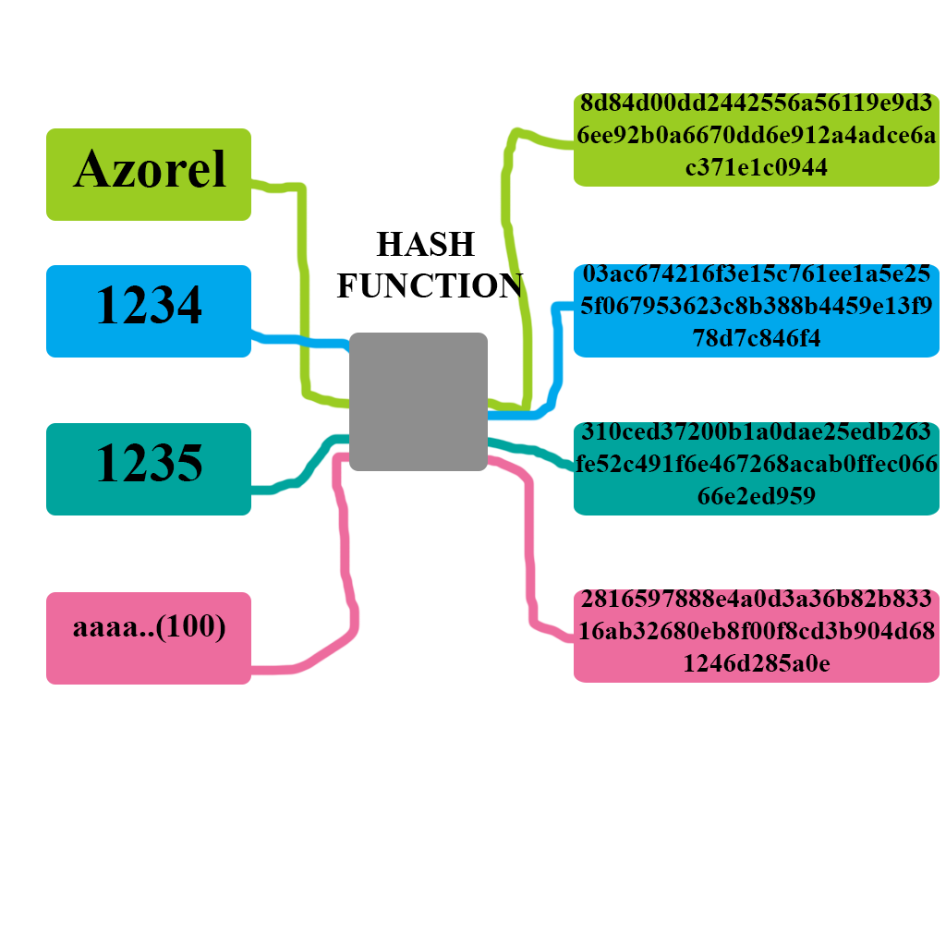
Hash functions take an input from an infinite space and map it to an output in a finite space. Due to the pigeonhole principle, any hash function will produce “collisions” or a situation where two inputs map to the same output. Cryptographic hash functions however must have a property known as collision resistance - meaning that given any pair (input˙1, output) an adversary only has a negligible chance of finding input˙2 that maps to the same output.

Slide 20
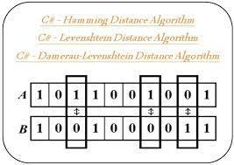
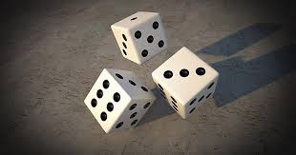
Another important property of cryptographic hash functions is their pseudo-random behavior. A cryptographic hash must not leak any information about the original message and reversing a hash into the input must only be achievable with negligible probability. Additionally the hamming distance any two digests must leak no information about the hamming distance between the inputs.

Slide 21
(Cryptographic) Hash functions are a cornerstone of the Blockchain – linking blocks together and providing trust through proof of work being the two most important uses. Each link in chain contains transactions and a hash to the previous block. The proof of work is then computed over the entire data of the block, including the hash of the previous link. This makes modifying data in any way unfeasible. For example, consider users Alice, Bob and Charlie and a block where the transactions “Alice gives Bob 100$” and “Alice gives Charlie 50$”. If Alice wanted to modify the block in any, or remove it, the change would corrupt the proof of work of the entire chain from that link forward.

Slide 22
Merkel Trees
A Merkel tree is a tree in which the value of any node that is not leaf is equal to the hash of the concatenation of the values of its children, and the values of the nodes that are leafs are hashes of the some fragment of data, alongside a pointer to that data. Consider some data, a hash of the data and a Merkel tree of that data. If the original data is corrupted in any way, both the hash and the root of the Merkel tree will be able to indicate that, however the Merkel tree is able to tell precisely which fragments have been altered/corrupted. This structure can be used on distributed systems to verify integrity of data. In the Blockhain, Merkle trees are used to create a cryptographic summary of the block, with transactions being leaves in the tree

Slide 23



Digital Signatures
Digital signatures are mechanisms derived from public key cryptography that ensure the authenticity, integrity and non-repudiation of a message. A digital signature scheme has 3 components:
Key generation algorithm
Signature generation algorithm
Signature verification algorithm.

Slide 24
Types of digital signatures
There are multiple types of digital signatures:
• plain
• aggregate •
multi-signatures •
threshold
• forward-secure

Slide 25
Plain digital signature
A way of signing message by one user. The current standard is RSA that generates the signature by taking a message, hashing it and then encrypting it with the private RSA key. To verify the signature, the algorithm takes the received signature and decrypts it using the public key

Slide 26
Aggregate signatures
Given the signatures of multiple users on one particular message, aggregate signatures create a more compact single signature. In Blockchain, aggregation can be used to decrease the storage footprint of multiple signatures. Given that in Blockchain, the same data is stored in multiple places, the impact can be quite important.

Slide 27
Multi-signatures
Multi-signatures allow multiple parties to create a joint signature on a message. More na¨ıve implementations concatenate the signatures of all users, but there exist specialized multi-signature algorithms create more compact signatures in terms of length. In Blockchain, multi signatures can be useful for MIMO transactions – multiple input multiple output

Slide 28
Threshold signatures
A specific kind of multi signatures where, given N parties, a common signature will be generated if and only if at least K parties, with K ¿= Threshold T collaborate.

Slide 29

Verifiable random functions
Verifiable random functions (VRFs) can generate pseudorandom values along with proof of their correctness.

Slide 30

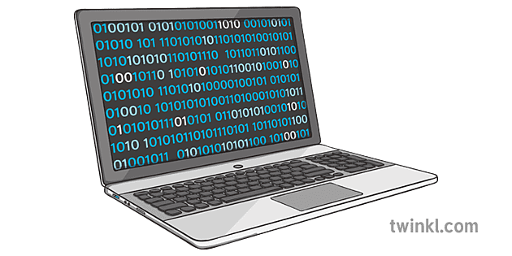
VRFs - Properties
Uniqueness: for any seed of the VRF there must be exactly one pair (r, π) that is accepted by the verification algorithm
Provability: if the output of the VRF was correctly computed and has not been tampered with the verification algorithm will always accept it
Pseudorandomness: the pseudorandom output cannot be distinguished from actual randomness

Slide 31

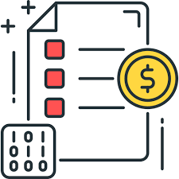

VRFs use cases
Proof-of-stake consensus algorithm
Smart contracts
Fairness in unbiased decision making

Slide 32
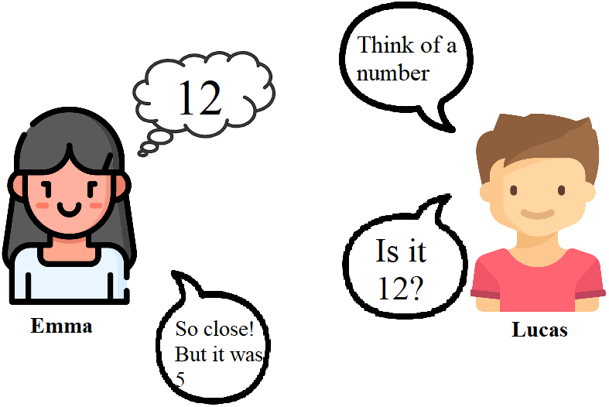
Commitment schemes
Let’s suppose Emma and Lucas want to play guess the number.. but what is stopping Emma from cheating?

Slide 33

Commitment schemes
Sometimes it can be useful for two parties that do not necessary trust each other to be able to have a system in which someone can commit to a certain value and keep it hidden until a later reveal phase while someone else can be sure that the committed value will not be changed even if it isn’t visible at the moment. This is realized with the help of commitment schemes.

Slide 34
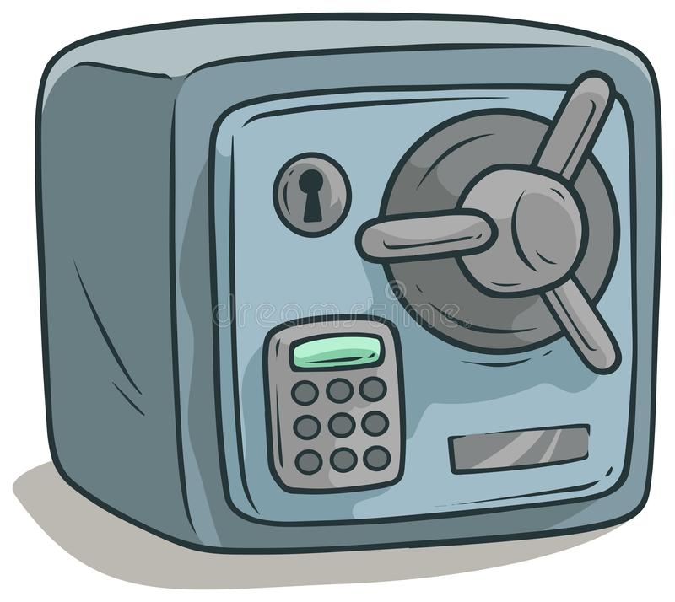
Commitment schemes
A commitment scheme can be seen as a digital safe in the following way: a sender chooses a message and commits to it by putting it inside the safe and locking that safe with a key. The sender then gives that safe containing the message to a receiver without the key to unlock it. At the reveal phase the sender will give the key to the receiver to open the safe and reveal the committed message.

Slide 35
Commitment schemes - Properties
Hiding: the committed message stays hidden until the sender reveals it
Binding: The sender cannot successfully reveal another value than the committed value
Correctness: A honest sender should be able to efficiently encode a committed message and reveal it in the future while a honest receiver should be able to efficiently check it

Slide 36
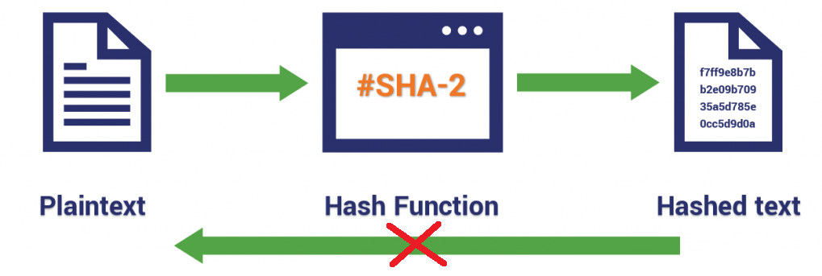
Commitment schemes based on hash functions
To compute a commitment output we have to make use of some one way function so the hiding property can be fulfilled. This makes cryptographic hash functions a good candidate for this role. Once the message is revealed the verifier can simply compute the hash function themselves.

Slide 37
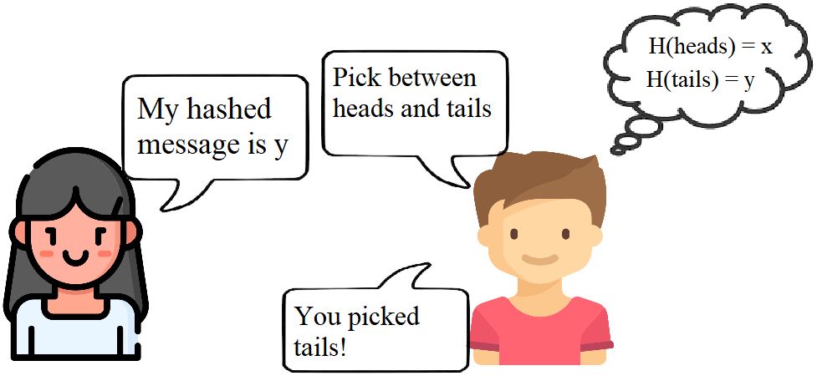
Commitment schemes based on hash functions
But what if the message space is smaller?

Slide 38
Commitment schemes based on hash functions
Message space
Commitment space
In order to avoid an adversary receiver from being able to pre-compute all the possible hashes from the message space and match them with the received hash, some randomness is required. For this reason a sender should uniformly choose a random value r to concatenate at the end of the message m and send both m and r at the reveal phase
H(m||r)
c1
.
.
.
cn
m1
.
.
.
mn

Slide 39
Commitment schemes in blockchain
In blockchain, commitment schemes secure the integrity and privacy of data kept on the blockchain by creating a unique hash of the data and adding that hash in the block header. It allows anyone to verify the integrity of the data by recalculating the hash and comparing it to the one stored in the block header and also can be used to provide privacy to the data stored on the blockchain.

Slide 40
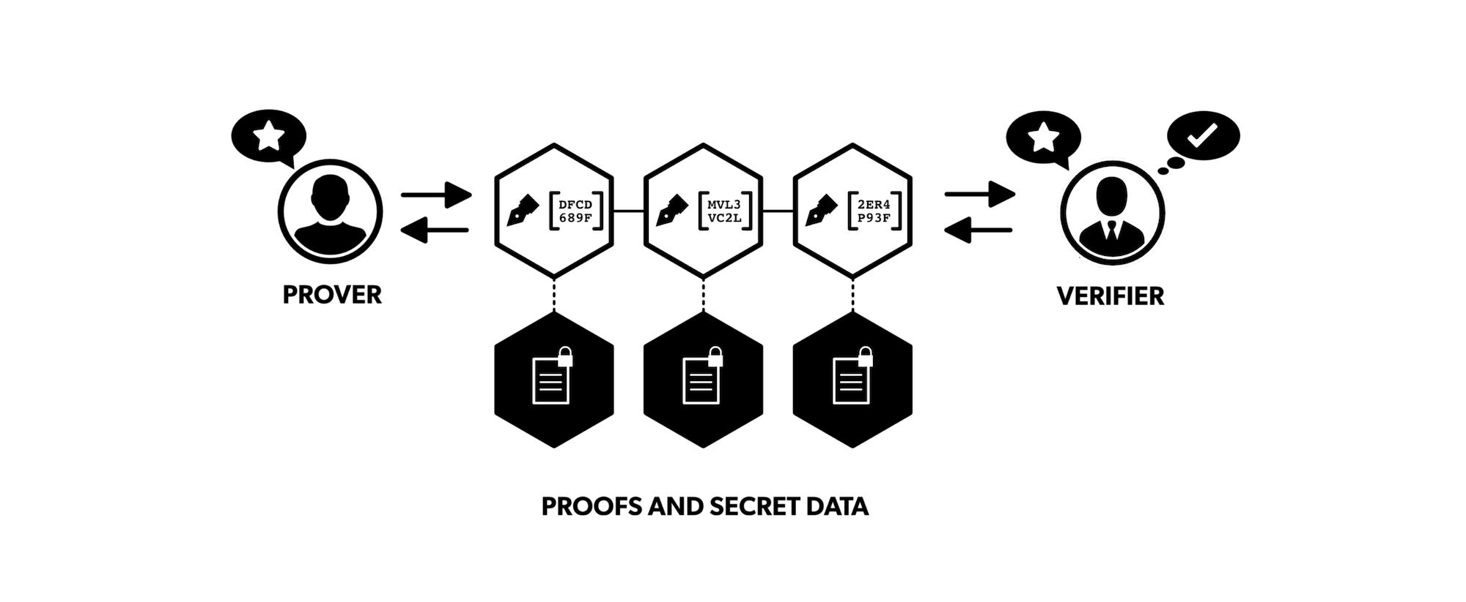
Non-interactive proofs
To discuss about non-interactive proofs we have to mention interactive zero knowledge proofs. Their purpose is to allow a prover to prove to a verifier that he knows a secret without revealing the secret itself.

Slide 41
Non-interactive proofs
The need for non-interactive proofs started to grow as a consequence to the flaws of interactive zero knowledge proofs:
The only one convinced by an interactive zero knowledge proof is the verifier that interacts with the prover
The back and forth communication between the prover and the verifier can be resource intensive and inefficient
In non-interactive proofs a prover computes a proof that doesn’t require any additional advice and can be verified by anyone.

Slide 42
Non-interactive proofs - SNARGs, SNARKs and STARKs
SNARG: succinct non interactive argument system
SNARK: a succinct non interactive argument of knowledge
STARK: a scalable transparent argument of knowledge
Both SNARGs and SNARKs have the property of perfect completeness.
SNARKs must have a short proof and a fast verification algorithm.

Slide 43
Non-interactive proofs - SNARGs, SNARKs and STARKs
Advantages of STARKs over SNARKs:
proof generation doesn’t need a trusted setup
more transparent
quantum resistant
The disadvantage of STARKs over SNARKs is the proof size

Slide 44

Privacy Enhancing Protocols
Ring Signatures
Group Signatures
Zero-knowledge proofs

Slide 45
Ring Signatures
Ring Signatures allow any member of a group of user to sign a piece of information, while retaining their anonymity.
There is no requirement for a central authority for validation and coordination. Not even the users themselves have to know about the existence of each other.
Within a group of users, any member can sign a message and it remains impossible to trace the identity of the signer.

Slide 46

Ring Signatures
Main Properties:
Guarantee of untraceability of the signer
Retention of signers anonymity
Validation of signature’s authenticity

Slide 47
Ring Signatures
Scalability of a ring signature is an important aspect and deserves special attention
Variable size signatures
Constant size signatures

Slide 48
Ring Signatures
Ring signatures with advanced security properties see an increased importance to be used for blockchain technologies.
Threshold ring signatures
Linkable ring signatures
Accountable ring signatures
Traceable ring signatures

Slide 49
Ring Signatures
Threshold ring signatures are a variant of ring signatures that requires a certain number of users to cooperate in the signing protocol.
Accountable ring signatures are a variant of ring signatures that is extended with an additional verifiable element allowing one designated receiver to revoke the anonymity of the signer if necessary

Slide 50
Ring Signatures
Linkable ring signatures make it possible for a user to identify whether any two signatures have been created by the same member of the ring.
Traceable ring signatures are in a way a combination of linkable and accountable ring signatures. The scheme is similar to the linkage ring signature, but in case a signer issues more than one signature using the same private key, that key is revealed.

Slide 51

Ring Signatures - Application
Ring signatures have been used by various cryptocurrencies to improve transaction privacy.
The original scheme of ring signatures might not satisfy all the needs for proper transactions, thus schemes with enhanced properties are being used.
Different cryptocurrencies use different protocols based on various types of ring signatures.

Slide 52

Group Signatures
A group signatures scheme is a method that allows a member from a group to sign a message on behalf of the entire group.
Group signatures imply that a group manager needs to be designated that would act as an overseer of the group.
Usually group signatures are not being applied in blockchain networks, because of the centralized role of the manager.

Slide 53
Zero-Knowledge Proofs
Zero-knowledge proof is a method that allows one party to prove to a second one that a given statement is true, while not disclosing any additional information about the statement apart from its validity.
In a zero-knowledge proof, both parties engage in a series of interactions in order for the prover to try to prove the validity of his knowledge.
Usually the parties are called the prover and the verifier.

Slide 54
Zero-knowledge Proofs
Main advantages of Zero-knowledge Proofs:
Concealment of certain parts of the communication
Guarantee of the authenticity of the messages
Retainability of confidentiality

Slide 55

Zero-knowledge Proofs
Basic properties:
Completeness
Soundness
Zero-knowledge
An additional property would be the inability to bring a past validation as evidence for current interaction’s validity.

Slide 56
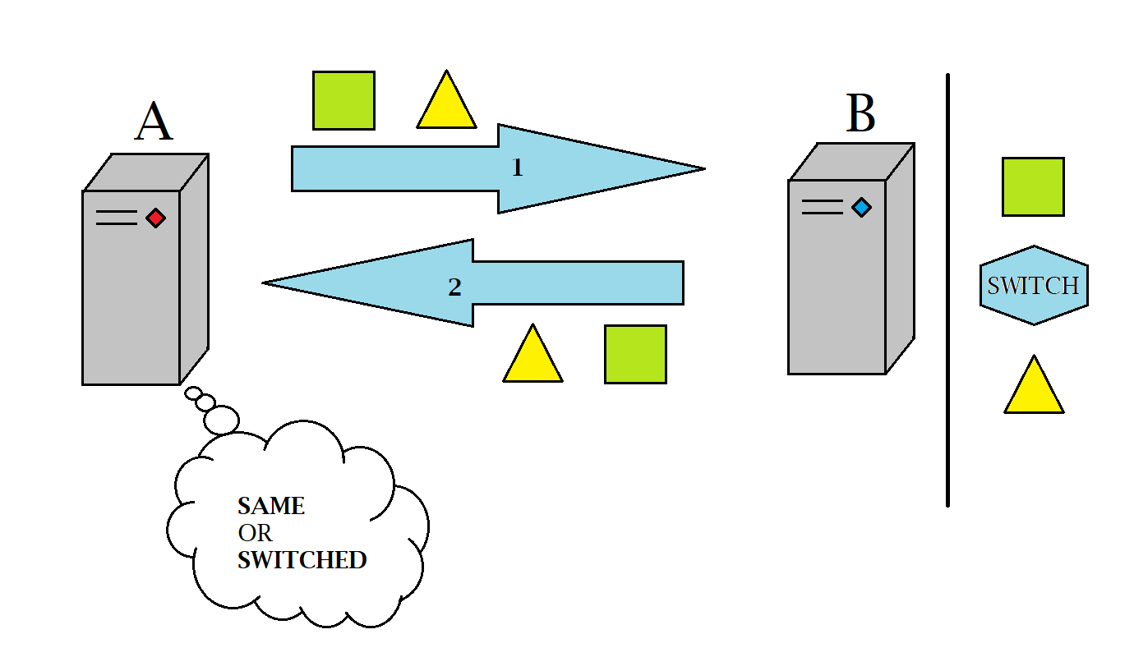
Zero-knowledge Proofs - Practical Example

Slide 57
Zero-knowledge Proofs - Application
Main fields of usage for zero-knowledge proofs are:
Blockchains
Nuclear Disarmament
Authentication Systems
Ethical Behavior

Slide 58
Secure Multi-Party Computation
The secure multi-party computation is a security definition that tries to model in real life a protocol that would simulate an ideal functionality.
There should exist a trusted third party (TTP) that would be able to get the input from any user and securely compute it and return the result.
The real world implementation replaces the TTP with a cryptographic protocol that aims at protecting input-output privacy of players and the correctness of the computation.

Slide 59
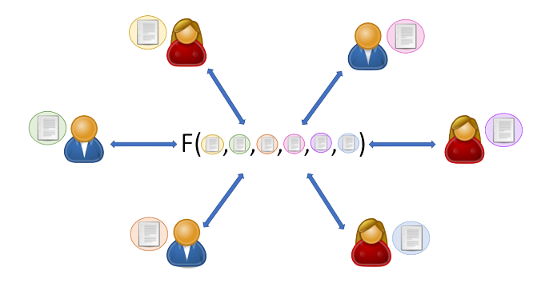
Secure Multi-Party Computation
Main security requirements:
Confidentiality
Correctness
Guaranty of information reception

Slide 60
Secure Multi-Party Computation - Application
The major impact of Multi-Party Computation in blockchain technology is related to the issue of long common reference strings required for zk-SNARKs.
Due to the fact that the generation of the common reference string is fundamental for the whole scheme, a violation in its generation may compromise the security of the whole system.
Multi-Party Computation offers a way to allow many volunteers to join the computations in order to generate the common reference strings.

